Slide 1

Workshop Setup
Join https://ahaslides.com/microng
Clone the following repos
https://github.com/owenmecham/module-federation-2022
https://github.com/owenmecham/ngrx-starter-2022
Install the Angular CLI
npm i -g @angular/cli
Install yarn
https://yarnpkg.com/lang/en/docs/install/

Slide 2
Code of Conduct
https://2022.ng-conf.org/code-of-conduct/
Report via email at info@ng-conf.org
Avoid Offensive Language
Avoid topics and issues that are polarizing
Avoid trying to further romantic interests
Avoid dishonesty and bullying

Slide 3
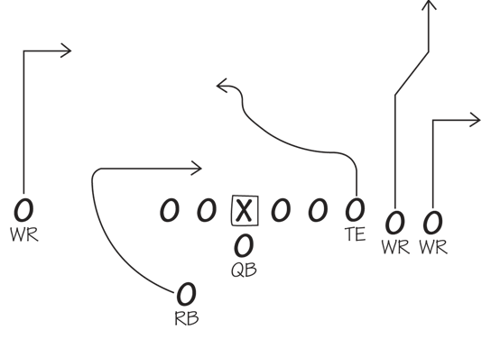
Micro-Frontend Playbook

Slide 4
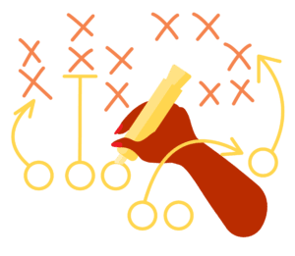
The Importance of a Playbook
The playbook helps the team visualize targets, understand the continuous improvement model, and know what is needed to achieve goals and be successful

Slide 5
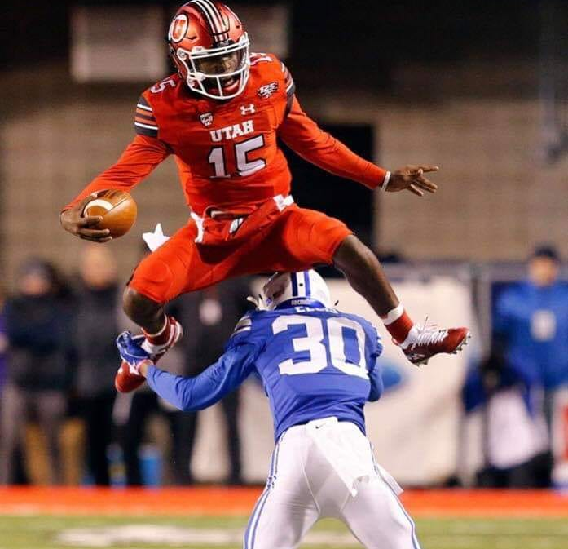
Utah vs BYU Rivalry Game 2018
Utah Unbeaten Since 2010
Fierce Rivalry
Notes:
Sadly we lost last year... All my daughters friends beat up on me in my own house

Slide 6

Utah vs BYU Rivalry Game 2018
Utah Unbeaten Since 2010
Fierce Rivalry
https://www.youtube.com/watch?v=H-H-gm6-6rE

Slide 7

Utah vs BYU Rivalry Game 2018
Utah Unbeaten Since 2010
Fierce Rivalry
Utah Wins 35-27

Slide 8

You Need a Web Application Playbook
Micro Frontends
Monorepos
JAMStack
SSR
Web Assembly
Module Federation

Slide 9




Who is Owen Mecham?

Slide 10
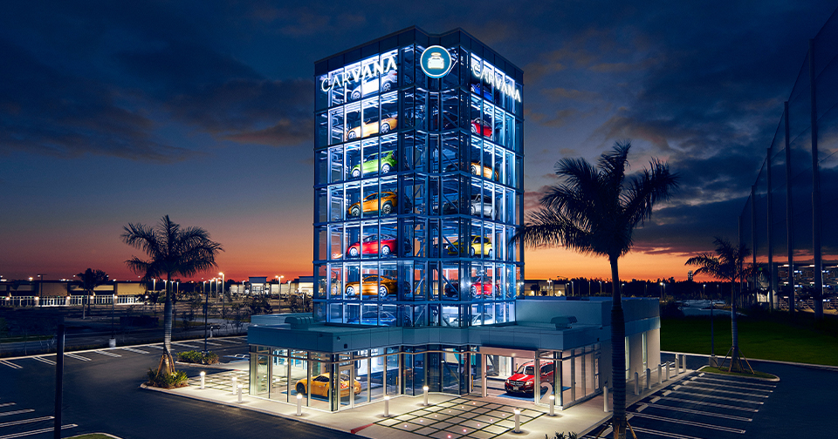



Who is Owen Mecham?
Husband and Father of 4 amazing daughters!
Director of Engineering
Conference Organizer

Slide 11


View from the “Office”

Slide 12
Agenda for This Workshop
Learn the Playbook (Micro Frontend Principles)
Learn about some new Plays
Exercise: Module Federation with Angular 14
Exercise: Dynamic Module Federation with a MFE Manifest
Exercise: Shared Libraries
Exercise: Loading Components via Module Federation as plugins
NGRX Walkthrough with Module Federation
Practice some of the current Plays
Exercise: Create Angular Element MFE
Exercise: Loading Angular Element MFE in another application
Exercise: Micro-Frontend Communication
Gift Card to Quiz Winner
Chat & Collab

Slide 13
Workshop Setup
Join https://ahaslides.com/microng
Clone the following repos
https://github.com/owenmecham/module-federation-2022
https://github.com/owenmecham/ngrx-starter-2022
Install the Angular CLI
npm i -g @angular/cli
Install yarn
https://yarnpkg.com/lang/en/docs/install/

Slide 14
Quiz Time!
https://ahaslides.com/microng

Slide 15
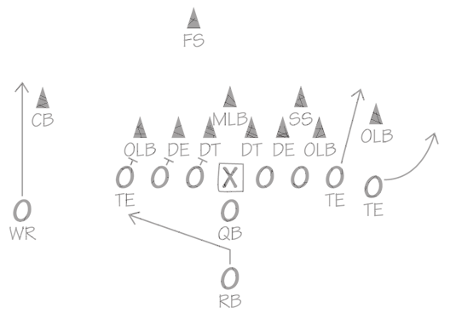
Micro-Frontend Definition

Slide 16

What is a Micro-Frontend?
Depends on who you ask?

Slide 17
What is a Micro-Frontend?
Loosely Coupled & Highly Cohesive UI Components or Apps
Independently Deployable
Source Code Isolation
Optionally Tech Stack Agnostic
The Goal is to enable teams to scale their application without sacrificing developer or user experience

Slide 18
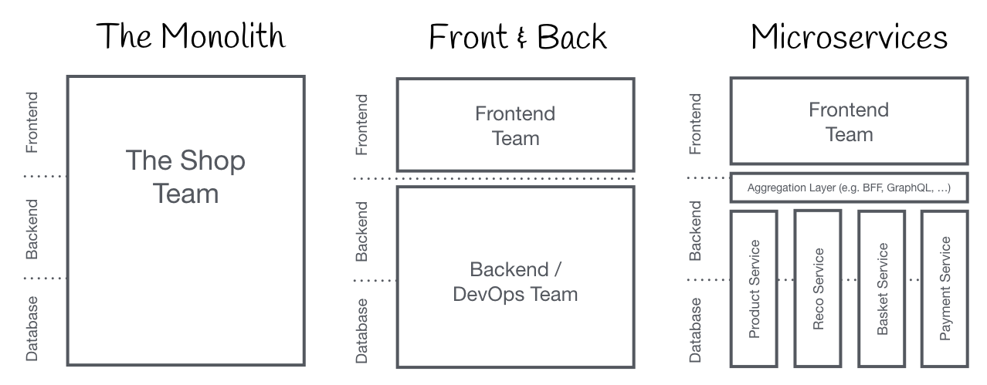
What is a Micro-Frontend?
Source: http://micro-frontends.org

Slide 19
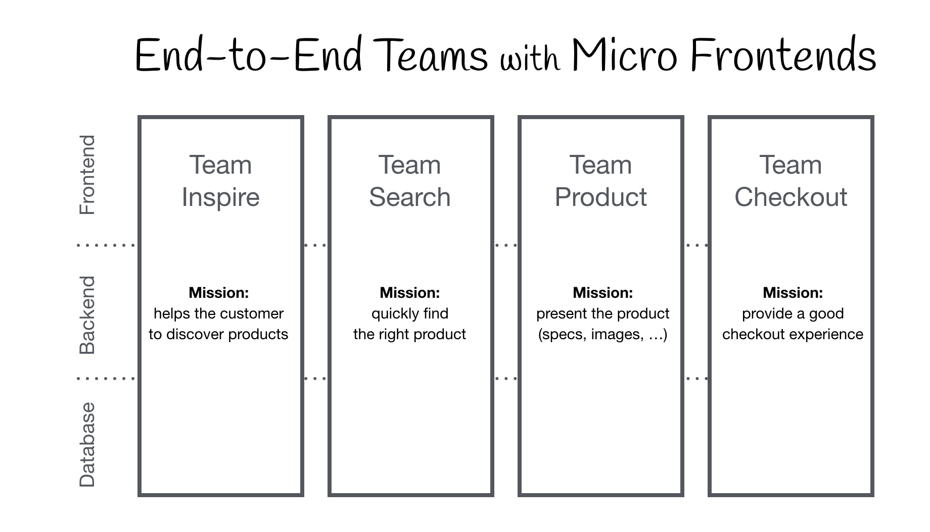
What is a Micro-Frontend?
Source: http://micro-frontends.org
Notes:
Source Code Isolation can be important

Slide 20
What is a Micro-Frontend?
API’s and Databases not always present
Source: http://micro-frontends.org
Notes:
Source Code Isolation can be important

Slide 21
Enterprise Use Cases

Slide 22
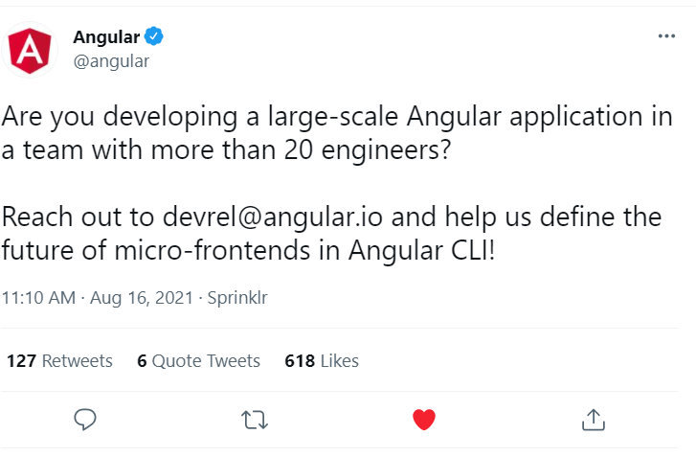
Exciting News for Micro-Frontends

Slide 23
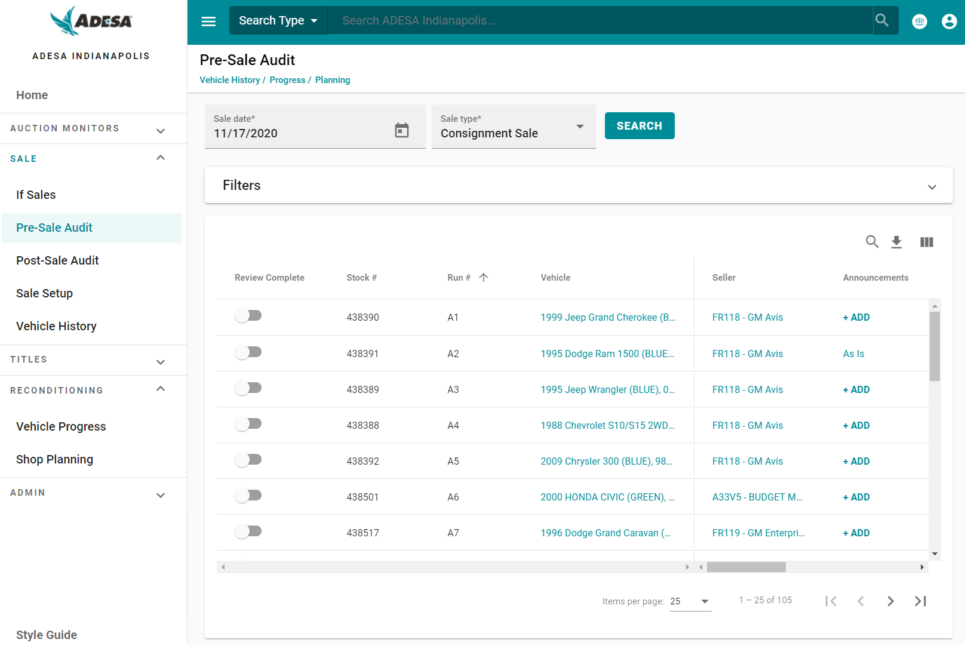
Functional Areas (Features)

Slide 24


Functional Areas (Features)
Frontend and APIs deploy together
Features align with Bounded Context
Once added to the App Shell, can be updated at any time
Can contain other Micro Frontends*

Slide 25
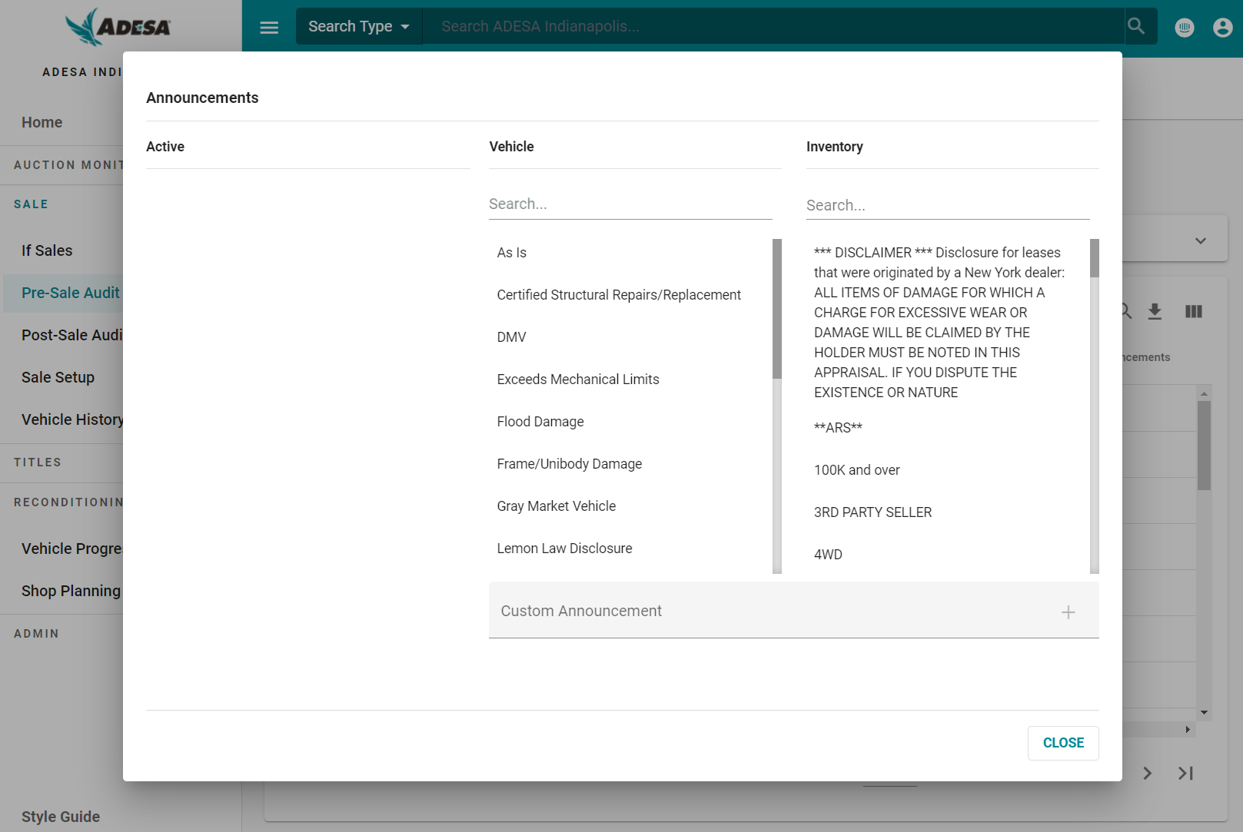
Functional Areas Nested MFE
Notes:
Consideration with Nested MFEs created with Angular Elements Each MFE contains the parts of the Angular Framework required, increasing the bundle size The plus to this approach is you are not coupled to a common version of Angular
We will talk about potential solutions later in the presentation

Slide 26
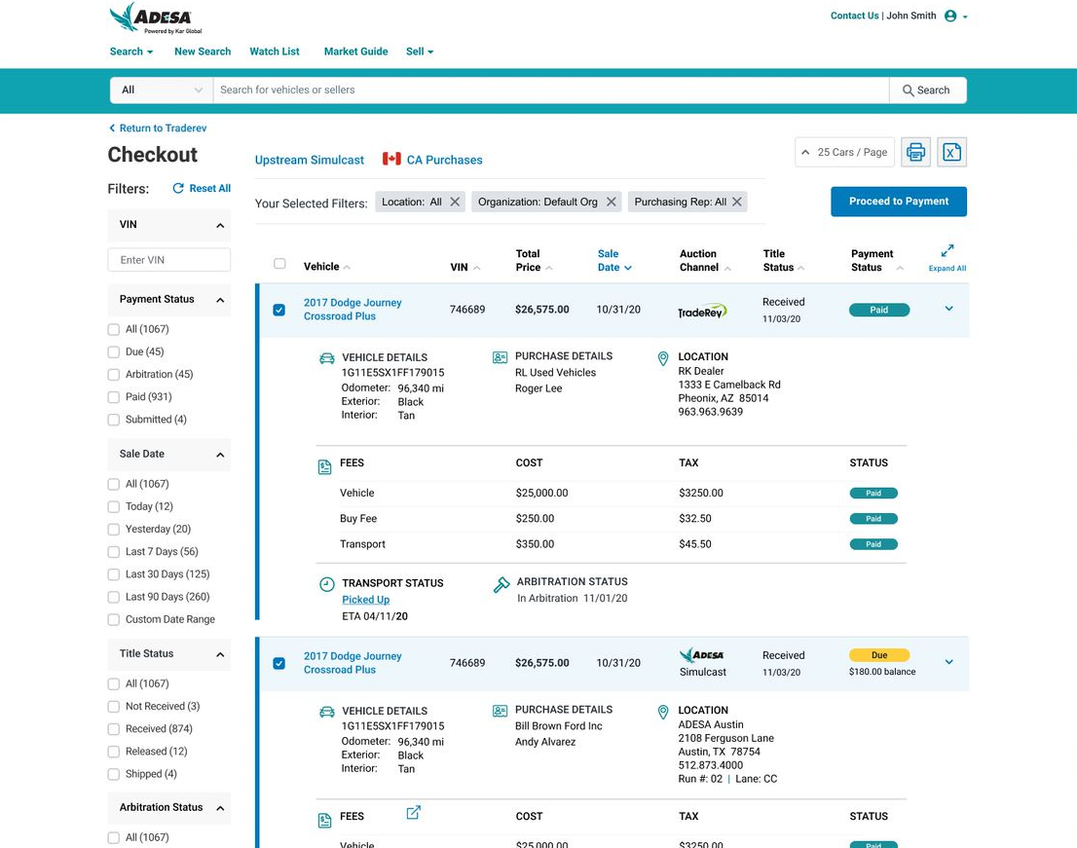

Full Applications Swapped with Route
Full Angular App
Roll your own or Single-Spa approach
Bootstraps the app on route change
Manfred Steyer

Slide 27
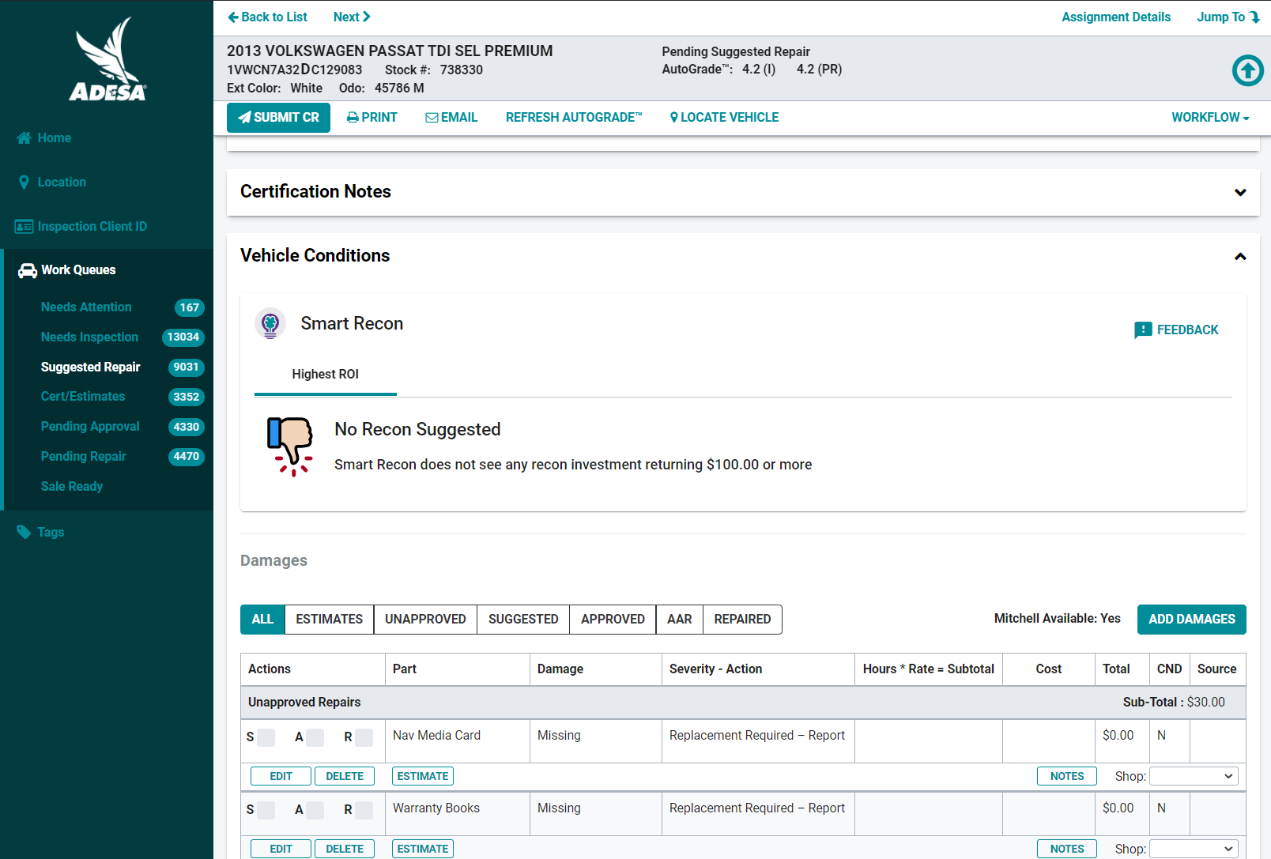
Composed Micro-Frontends
Legacy Application Modernization
Green-Field App
Need to have a strategy for dependencies
Notes:
Talk about communication from Angular components to jquery based app. Not difficult given that the DOM is the api with a custom element. Zone.js considerations. Legacy authorization considerations

Slide 28
Quiz Time!
https://ahaslides.com/microng

Slide 29
Implementation Options
Notes:
Angular Elements and Module Federation will be covered in more detail later on

Slide 30
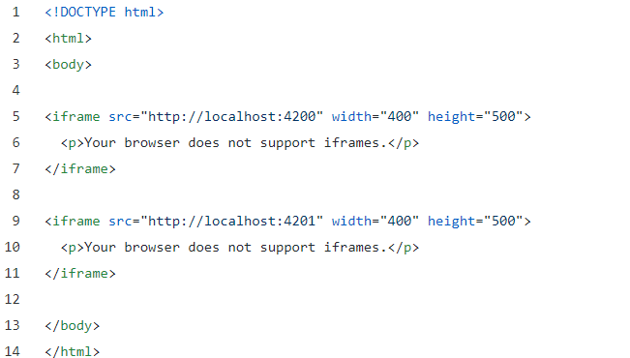

iFrames
Isolation of Apps
Communicate between iframes with Window.postMessage()
Notes:
Be sure to mention Conan Obrien? Who remembers Y2K?

Slide 31
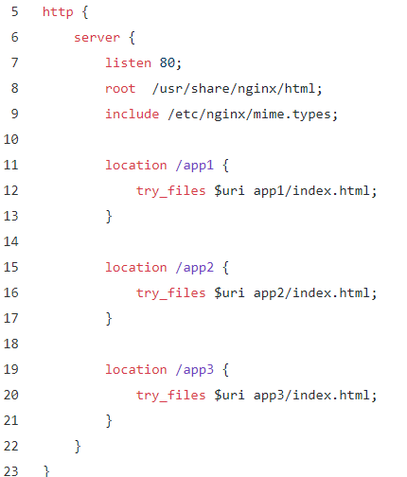
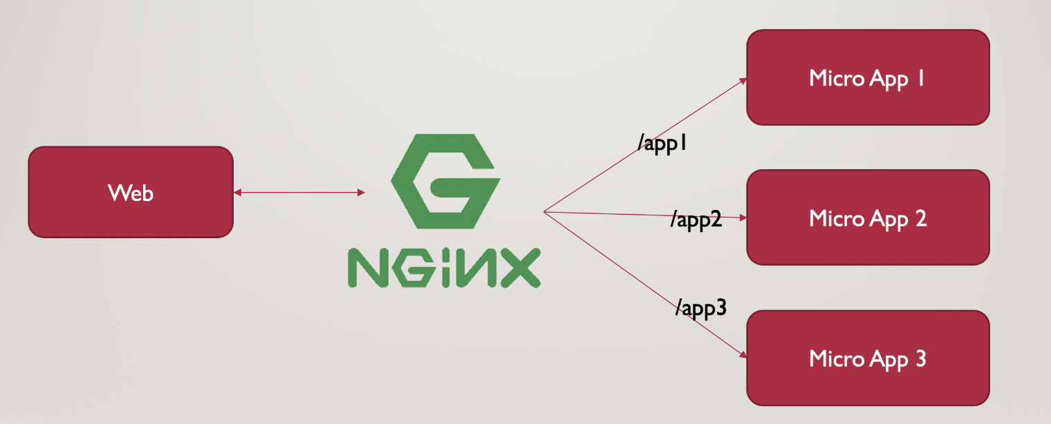
Reverse Proxy
nginx solution demonstrated by Bachina Labs
Hard refresh on navigation

Slide 32
Other Solutions
Bit.dev
Single SPA or Qiankun
SystemJS – Roll your own module orchestrator
Piral
Open Components
Luigi
Mosaic
Puzzle.js
Notes:
As with any third party dependency, make sure to vet the strength of community and portability of the solution

Slide 33
Pros and Cons

Slide 34
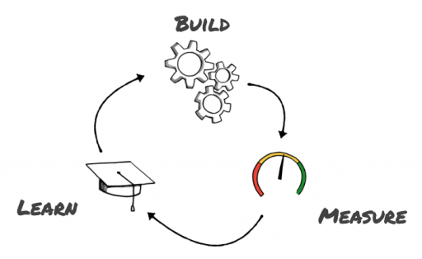
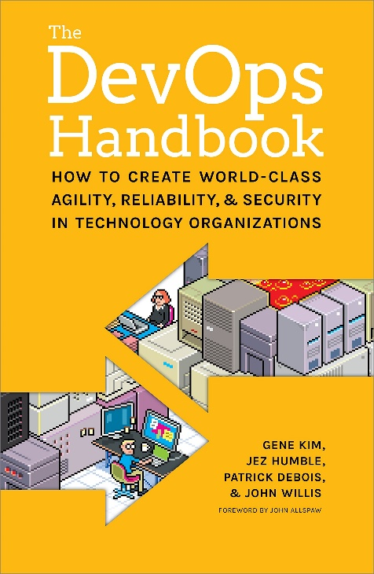
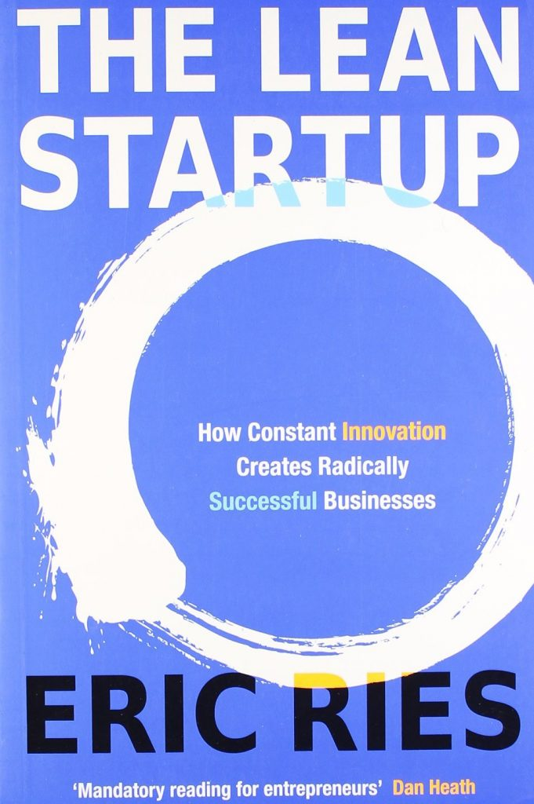
Why do we use Micro-Frontends?
Notes:
It’s about the process more than it’s about working with shiny new tech

Slide 35
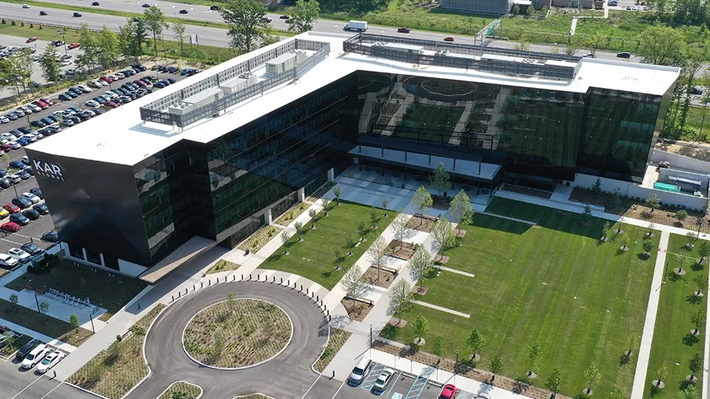
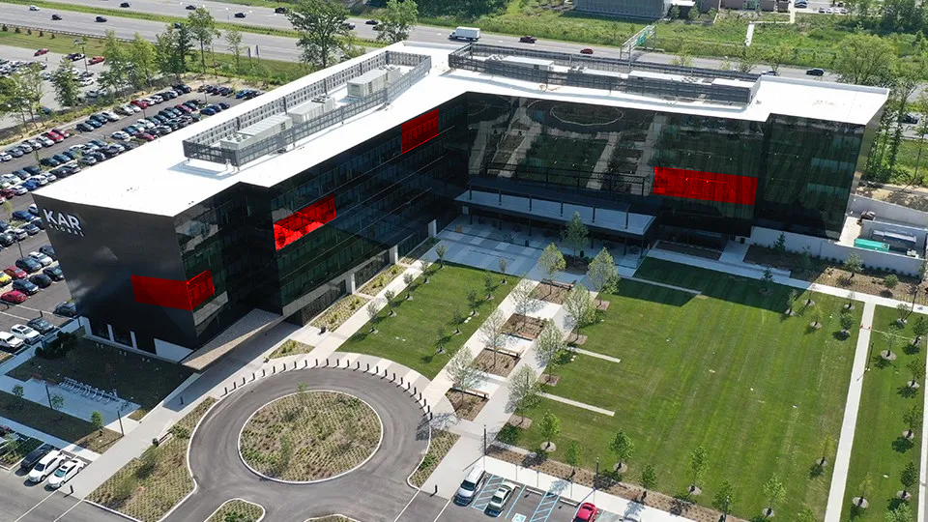
Startups Can Exist Within Large Corporations
AMP
AutoHawk
Smart Seller Recon
Simulcast+

Slide 36
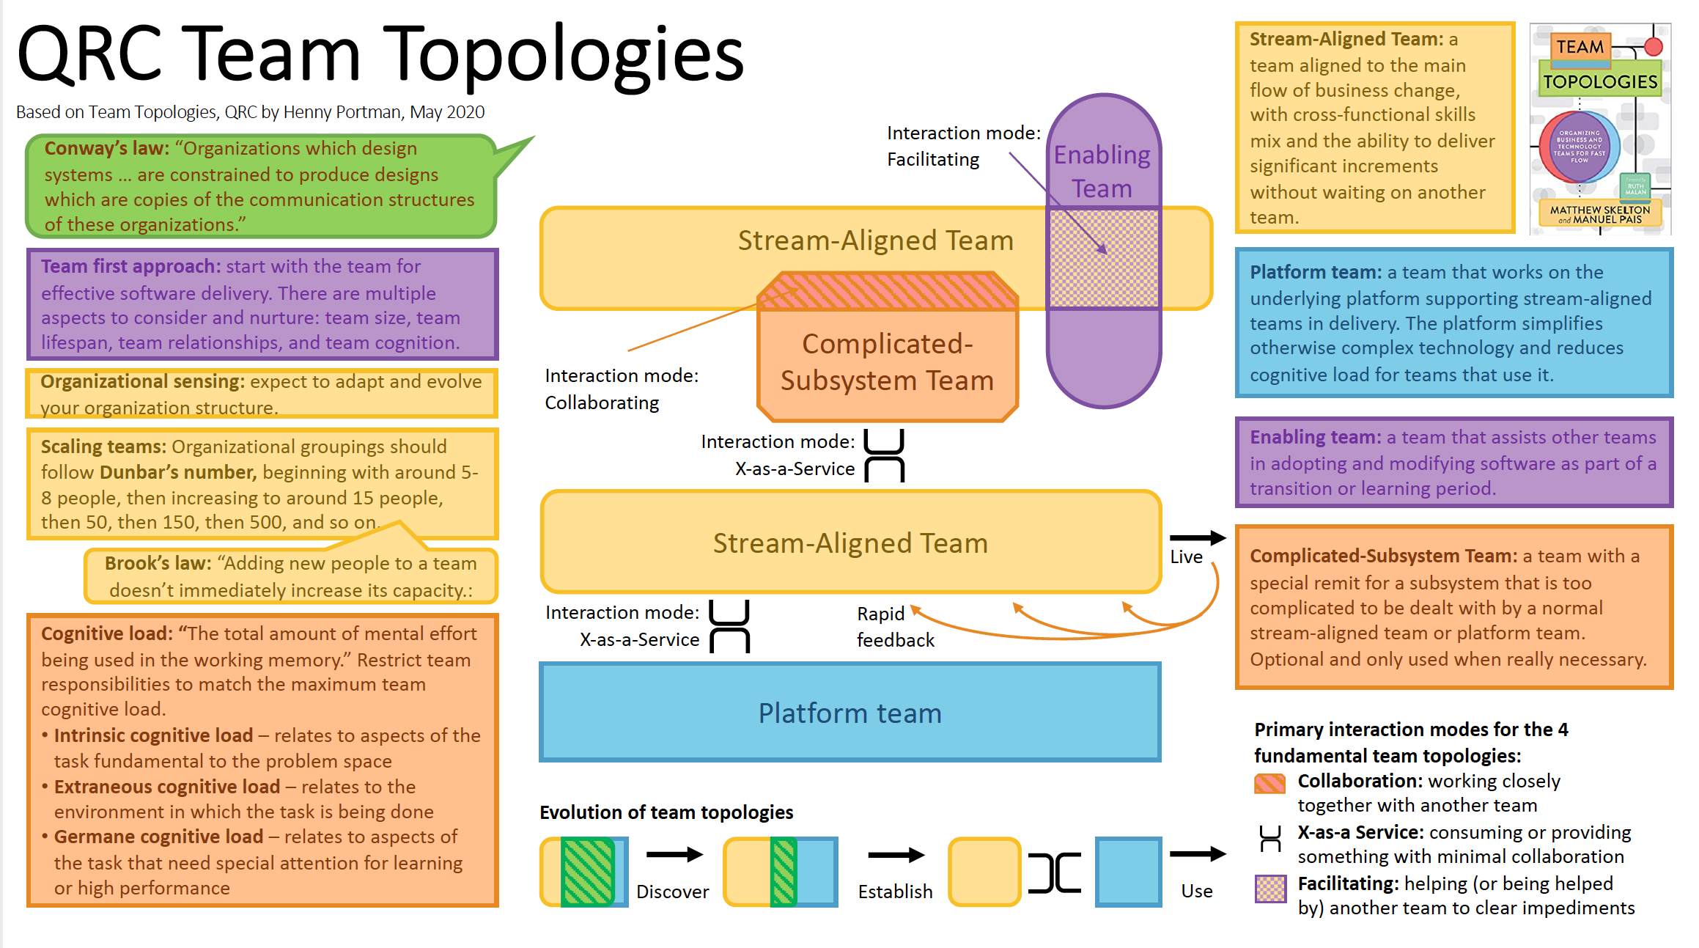

Slide 37
Why do we use Micro-Frontends
Fewer lines of code in each solution
Team Autonomy of tech stack
Streamlined Deployment
Focused unit testing
Teams can upgrade frameworks whenever they want
(See also Pitfalls)
Encourages a DevOps mindset
CI/CD pipelines, Infrastructure as Code

Slide 38
Potential Pitfalls
Framework Upgrades
You have a 1:1 ratio of repo to solution (Talk about alternative architectures)
Inverse relationship between bundle size and framework independence in @angular/element based MFEs
Learning Curve / Increased Complexity

Slide 39
Quiz Time!
https://ahaslides.com/microng

Slide 40
Should I use a Micro Frontend?

Slide 41
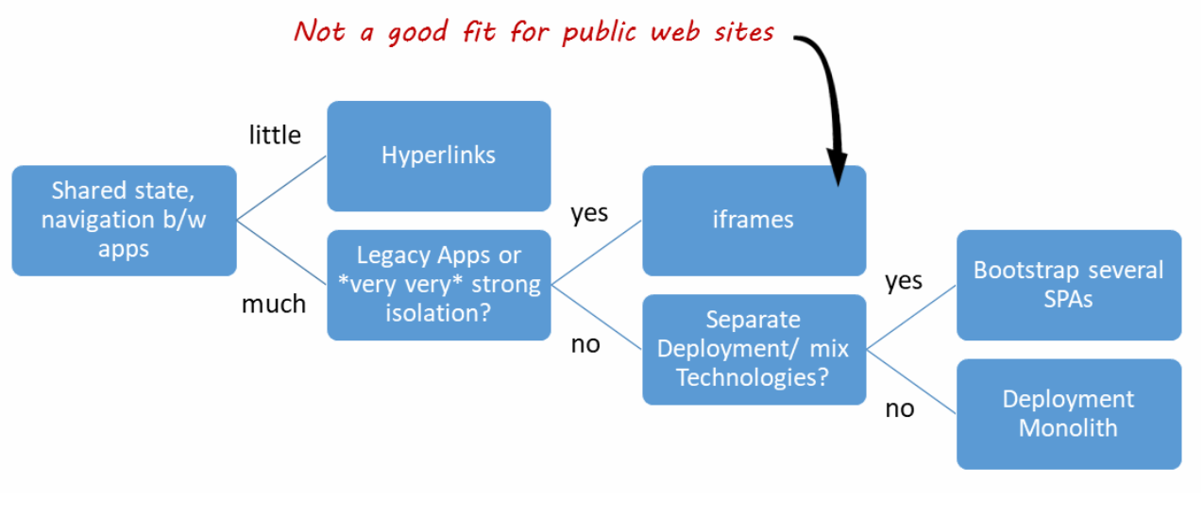
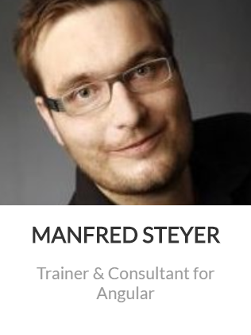
Decision Framework
https://www.angulararchitects.io/aktuelles/a-software-architects-approach-towards/
Notes:
Be sure to mention the. Iframe for public websites

Slide 42

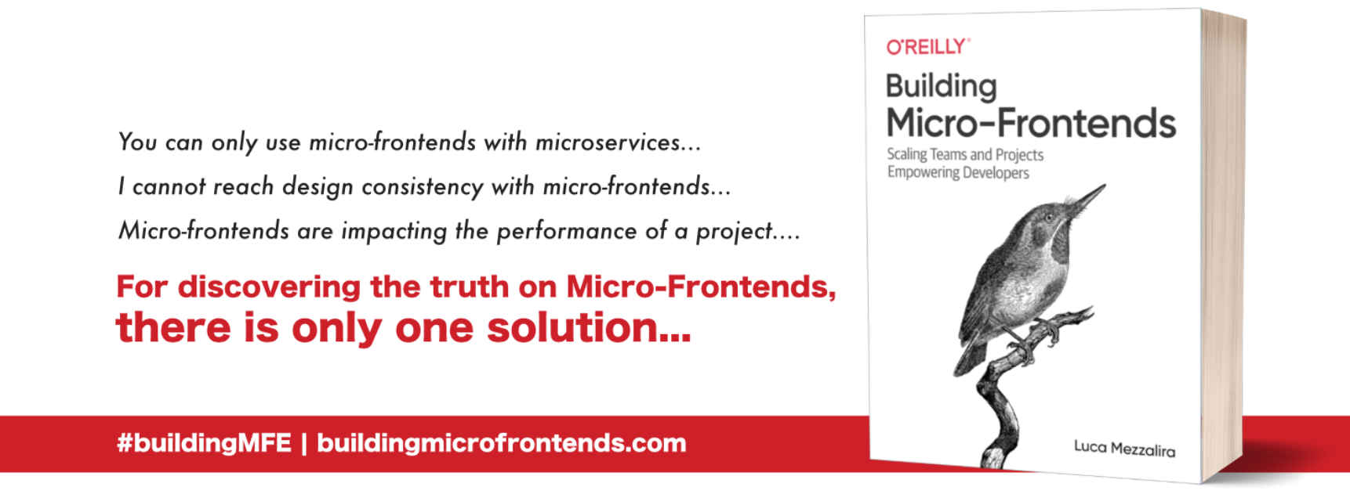
Decision Framework

Slide 43
Decision Framework
If you don’t need
Independent Builds and Deployments
Source code isolation
Mixed tech stacks
Then you are better off choosing a different web architecture

Slide 44

Choose the right architecture for the solution,
Don’t try to make all solutions fit into the same architecture
Notes:
Ask the attendees what they consider a Micro-Frontend?

Slide 45
Quiz Time!
https://ahaslides.com/microng

Slide 46
Micro-Frontends & Monorepos

Slide 47
Monorepo Considerations
Source Code Isolation Required?
Victor Savkin wrote about using Git Submodules, but you lose many of the benefits of the Monorepos like dependency checks
Dependency Checks via linting rules
Incremental Builds
Nx supports more than Angular
IMO: this decision is driven more by company culture and team topology than any other factor
Seeing individual teams create monorepos that contain the MFEs for the products within their domains

Slide 48



Monorepo Considerations
Monorepos and Micro-Frontends can

Slide 49
The Application Shell
Roles and Responsibilities

Slide 50

The App Shell
Authentication
Interceptors and Auth Functions should be bundled in an npm package or shared lib
Navigation
Router strategy can impact architecture
Notifications & Error Handling
Application Metric Tracking
Google Analytics, AppInsights, etc…
Locale selection
Event and Command based messaging
Should be as light weight as possible and load quickly
Notes:
Each individual MFE should handle it’s own authorization

Slide 51
Quiz Time!
https://ahaslides.com/microng

Slide 52
Micro-Frontend Communication
App Shell & Inter-Component

Slide 53
Communication Patterns
The DOM is the API
CustomEvents and Event Listeners
Some abstraction available with Eev
Unidirectional Communication Flow
Redux Pattern
Avoid coupling components to components

Slide 54
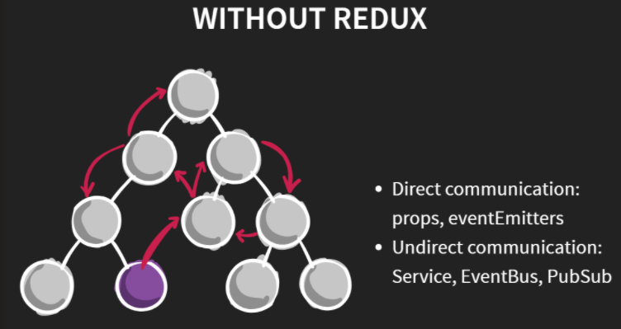
Communication Patterns
https://julienrenaux.fr/talks-src/2017/from-redux-to-ngrxstore/#/2

Slide 55
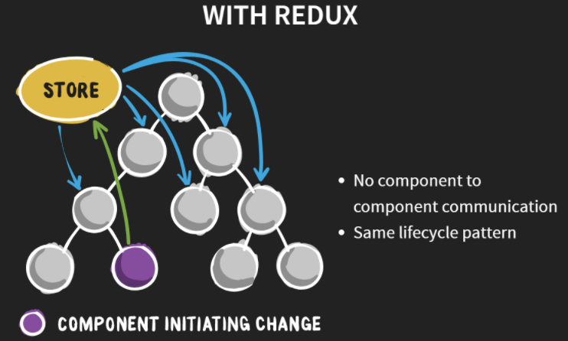
Communication Patterns

Slide 56
State Management Considerations

Slide 57
State Management
Router is the source of truth
Keep State Management as light as possible in Web Component based MFEs
It’s all code
Have used Akita or even RxJS Behavior Subjects
Synchronizing State in between the MFE and the Shell is a smell
Broadcasting events and allow other MFEs to respond
Could indicate that the boundaries for your MFE are too narrow
Align MFE Design with Domain Boundaries
Module Federation makes this easier with shared library singletons

Slide 58
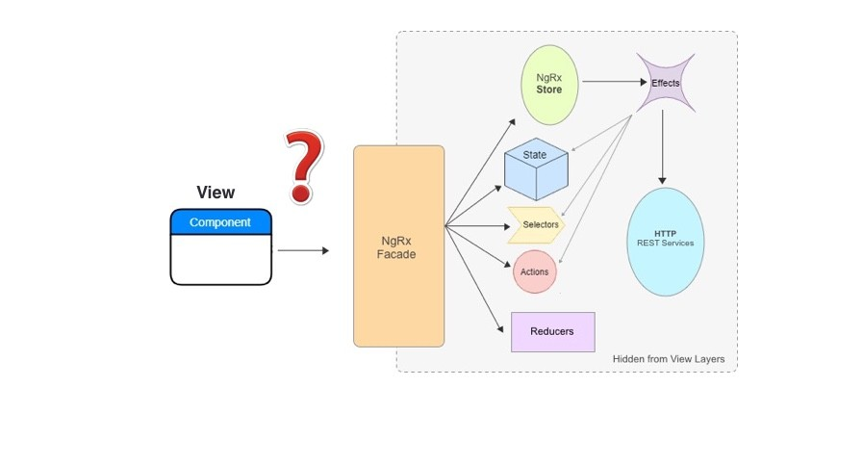
State Management
If a Shared State Store is required…
Consider using a fascade as an abstraction
<some-component></some-component>

Slide 59
State Management Isolation
Keep MFE State Isolated from the App Shell

Slide 60
State Management Uncommon

Slide 61
State Management Uncommon
Data Saved to Micro –Service API Automatically

Slide 62
State Management Uncommon

Slide 63
Quiz Time!
https://ahaslides.com/microng

Slide 64
Building Micro-Frontends
Angular Elements Approach

Slide 65
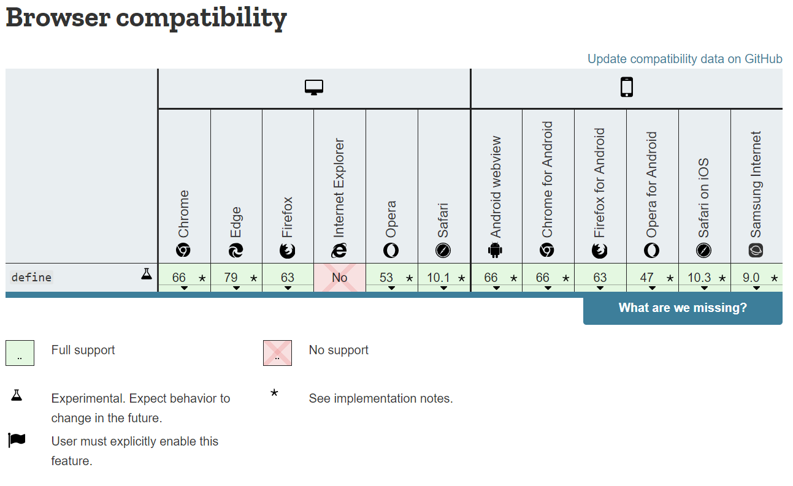
Angular Elements
Notes:
What types of apps are you building? Who are your customers? Which browsers do you need to support? These answers can affect which approach you take to building MFEs

Slide 66
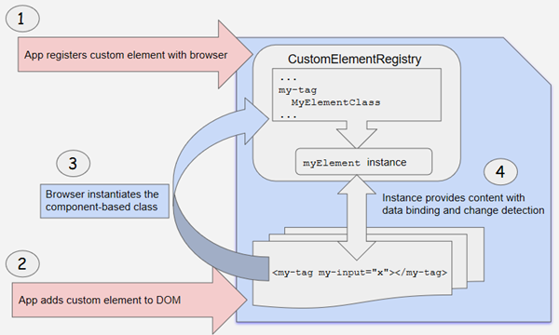
Angular Elements
Notes:
Source Code Isolation can be important

Slide 67
ngx-build-plus
The Secret Sauce

Slide 68
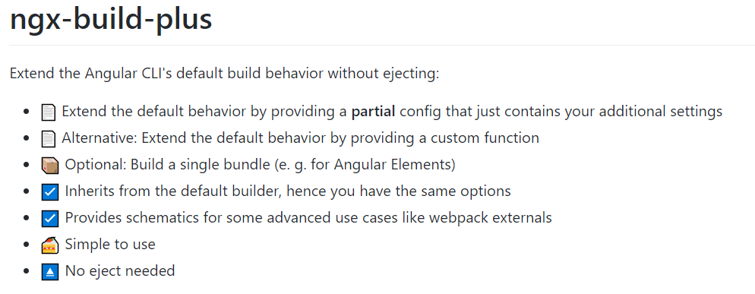
ngx-build-plus
Will be covered during the exercises
Notes:
Ngx-build-plus extends the angular cli and can create a single bundle for our web component assets. Talk about Externals

Slide 69
ngx-build-plus
Sharing dependencies via externals for Angular <= 12
For Angular 13 plus, if you need to do this for legacy app migration, check out
https://github.com/peterblazejewicz/angular-umd-bundle
Notes:
Ngx-build-plus extends the angular cli and can create a single bundle for our web component assets. Talk about Externals

Slide 70
Loading Micro-Frontends

Slide 71
Loading Strategies
Optimize for Immediate Changes
Reload script on each invocation
Optimize for Performance
Load once until app re-bootstraps
Hybrid approach
https://medium.com/@tomastrajan/the-best-way-to-lazy-load-angular-elements-97a51a5c2007
https://angular-extensions.github.io/elements/#/home
Notes:
Source Code Isolation can be important

Slide 72
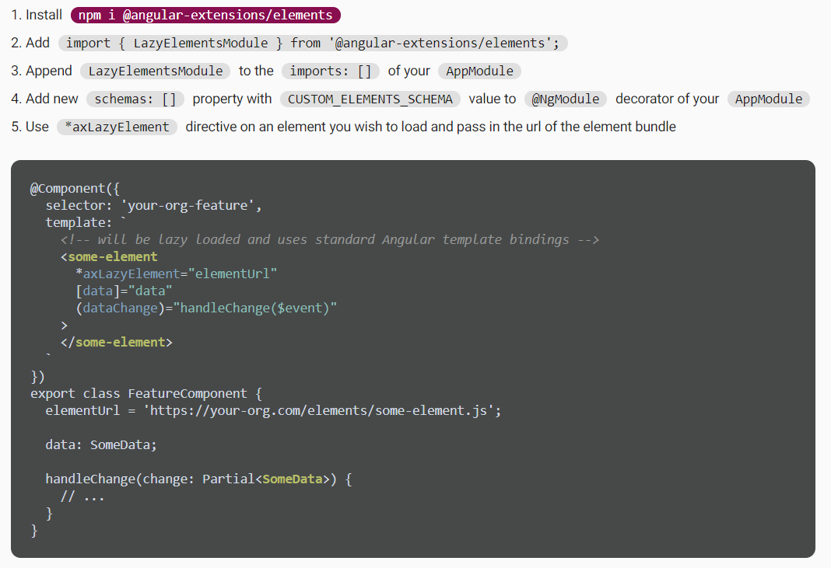
Loading Strategies
Notes:
Source Code Isolation can be important

Slide 73
Component Libraries
Managing Shared Dependencies, Design Systems, etc.

Slide 74
What do you control?
DRY
Auth
Interceptors
External Consumers
Embed Style with Shadow DOM
Control the entire ecosystem
Inherit Styling
Multiple Builds depending on consumer
Localization
Keep it Dynamic - Transloco
Notes:
Source Code Isolation can be important

Slide 75
Quiz Time!
https://ahaslides.com/microng

Slide 76
Enterprise Delivery
CI/CD, Localization, Testing, & Hosting.

Slide 77
Testing for Web Comonent Based MFEs
Unit Tests in Micro-Frontend Solution
Create a slim App Shell project for e2e testing during development and deployment
Alternatively, build the production app shell as an npm package that can be shipped along side each micro frontend for e2e testing
Consuming Applications of the Micro-Frontend should only have a simple smoke test to make sure the MFE loads
Avoid coupling the production App Shell to the Micro Frontend
More on Module Federation Testing later…
Notes:
Source Code Isolation can be important

Slide 78
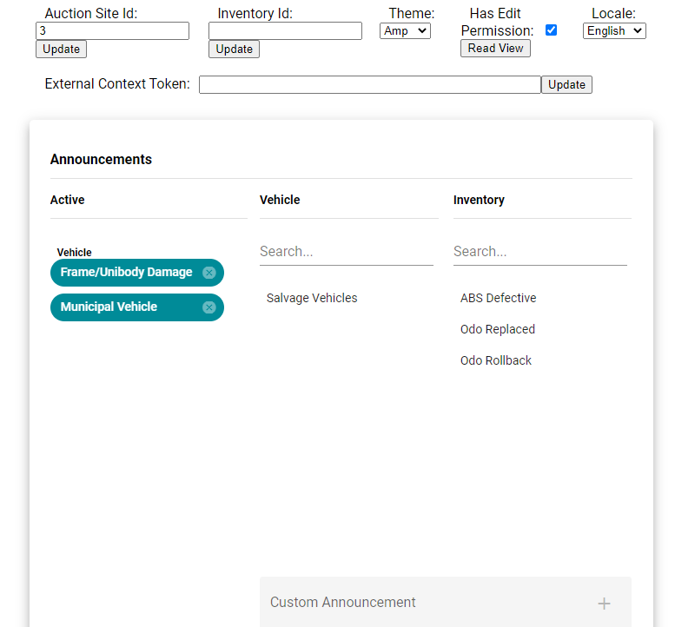
Testing
Notes:
Source Code Isolation can be important

Slide 79
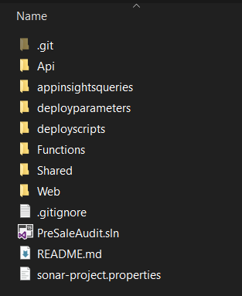
Application Build
Complete Solution Code in a single git repo
If the MFE is responsible for mastering data
If you have to deploy one project before another project to make sure tests pass, you have a problem
This avoids dependency issues
Notes:
Source Code Isolation can be important

Slide 80
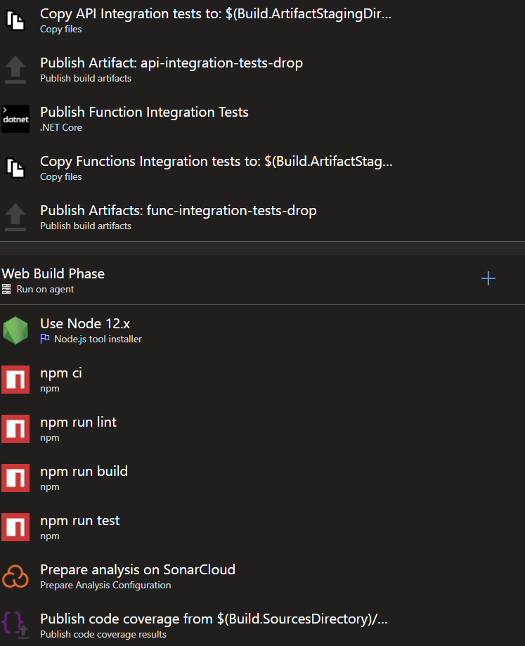
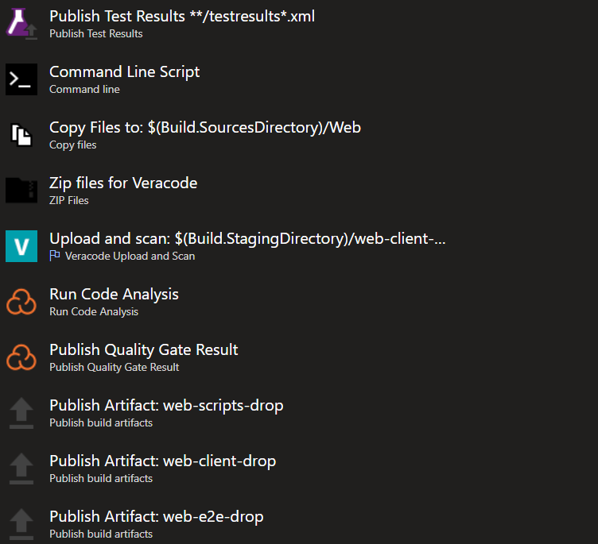
Application Build
Notes:
Source Code Isolation can be important

Slide 81
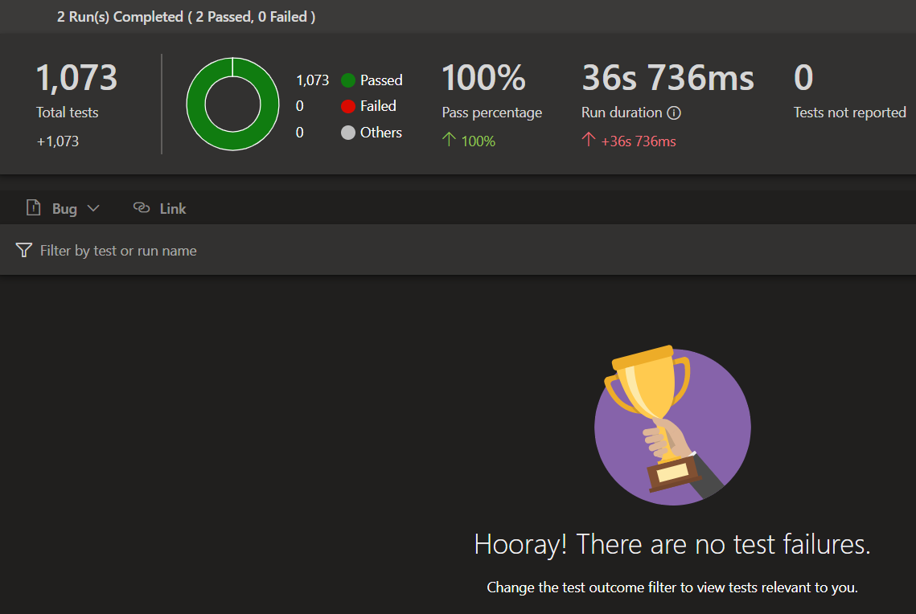

Application Build
Midday Deployments are impossible without comprehensive tests

Slide 82
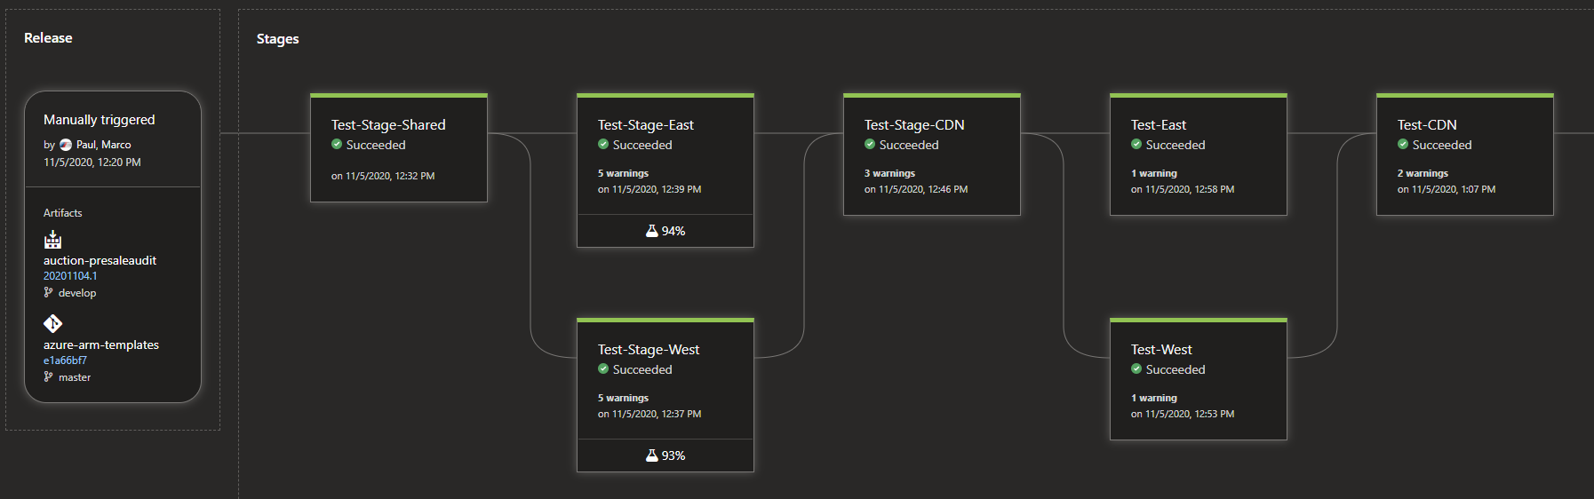
Application Release to CDN
Notes:
CORS configuration Caching Strategy Time for CDN updates to propagate to the endpoints in the network Cost benefits of using CDNs

Slide 83
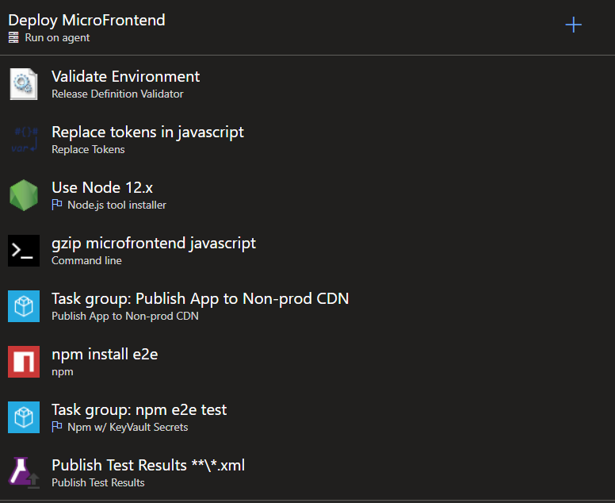

Application Release to CDN
Notes:
Costs, Feature Flags, etc…

Slide 84
The Future Now of Micro-Frontends
Module Federation & Webpack 5

Slide 85
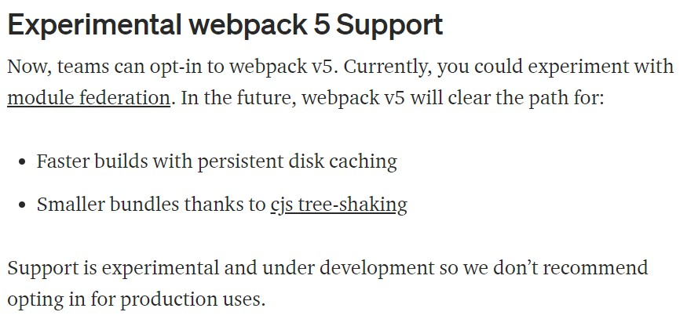
Module Federation from Angular 11 on
X
Notes:
Yarn is required currently to resolve to webpack 5

Slide 86
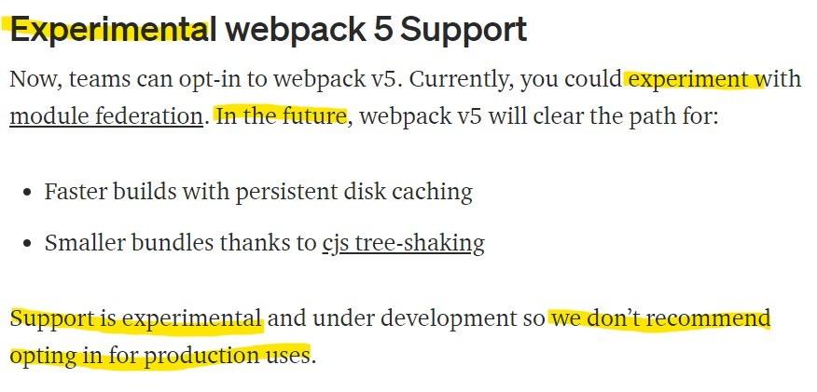
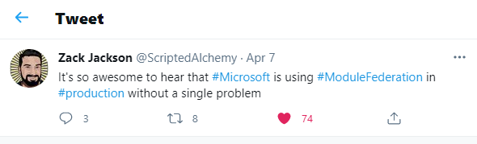
Module Federation from Angular 11 on
Notes:
Source Code Isolation can be important

Slide 87
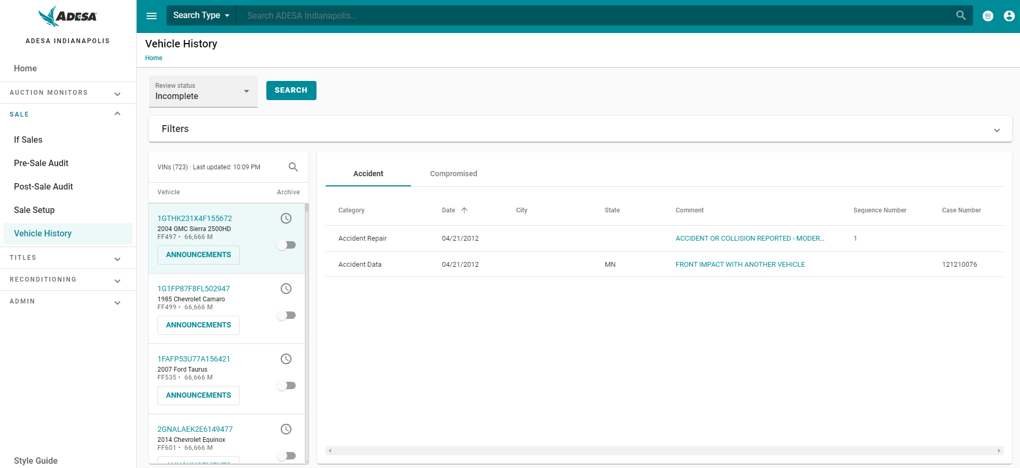
AMP – Web Components for MFE

Slide 88
Shell Code – Includes Angular
Angular/Core
Angular/Common
Angular/Router
Shell Code

Slide 89
MFE Code – Also Includes Angular
Angular/Core
Angular/Common
Angular/Router
Angular/Core
Shell Code
Angular/Common
Angular/Router
MFE Code

Slide 90
MFE Utopia – Shared Dependencies
Angular/Core
Angular/Common
Angular/Router
Angular/Core
Shell Code
Angular/Common
Angular/Router
MFE Code

Slide 91
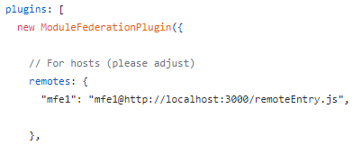
Module Federation: Host and Remotes v12
Host
Loads First
Loads other remote modules when they are needed dynamically
Notes:
Source Code Isolation can be important

Slide 92
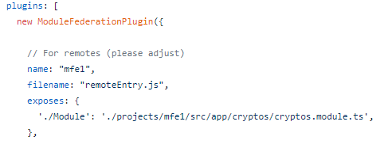
Module Federation: Host and Remotes v12
Remote
Loads On Demand
Exposes Angular Modules or Components as javascript modules
Dependencies resolved at runtime
Notes:
Source Code Isolation can be important

Slide 93
Module Federation: Timeline
Host
Pageload
Dependencies
@angular/core
@angular/common
@angular/router
Remote 1
remoteEntry.js
Dependencies
@angular/core
@angular/common
@angular/router
Remote 2
remoteEntry.js
Dependencies
@angular/core
@angular/common
@angular/router
@angular/material/card
Notes:
Source Code Isolation can be important

Slide 94
Module Federation: Timeline
Host
Pageload
Dependencies
@angular/core
@angular/common
@angular/router
Remote 1
remoteEntry.js
Dependencies
@angular/core
@angular/common
@angular/router
Notes:
Source Code Isolation can be important

Slide 95
Module Federation: Timeline
Host
Pageload
Dependencies
@angular/core
@angular/common
@angular/router
@angular/material/card
Remote 2
remoteEntry.js
Dependencies
@angular/core
@angular/common
@angular/router
@angular/material/card
Host
Pageload
Dependencies
@angular/core
@angular/common
@angular/router
Remote 1
remoteEntry.js
Dependencies
@angular/core
@angular/common
@angular/router
Notes:
Source Code Isolation can be important

Slide 96
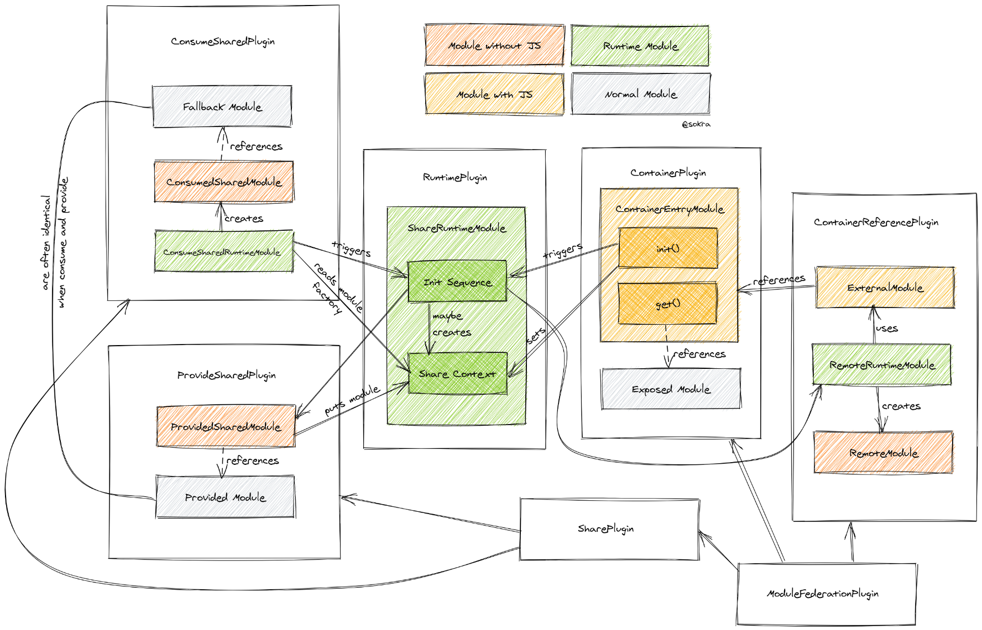
Module Federation
Source: https://medium.com/dev-genius/module-federation-advanced-api-inwebpack-5-0-0-beta-17-71cd4d42e534
Notes:
Source Code Isolation can be important

Slide 97
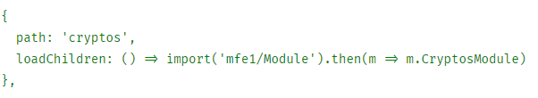
Module Federation: Host and Remotes v12
Host Webpack Config
Remote Webpack Config
Host Routes
Notes:
Source Code Isolation can be important

Slide 98
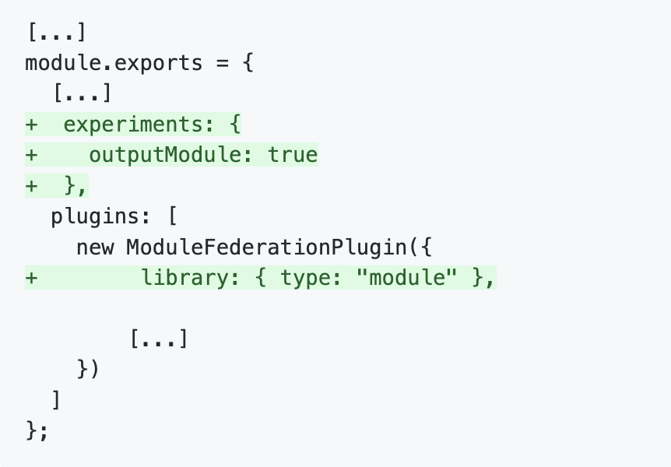
Webpack.config Changes for v13
Add the following to webpack.configs
https://github.com/angular-architects/module-federation-plugin/blob/main/migration-guide-13.md
Notes:
Source Code Isolation can be important

Slide 99
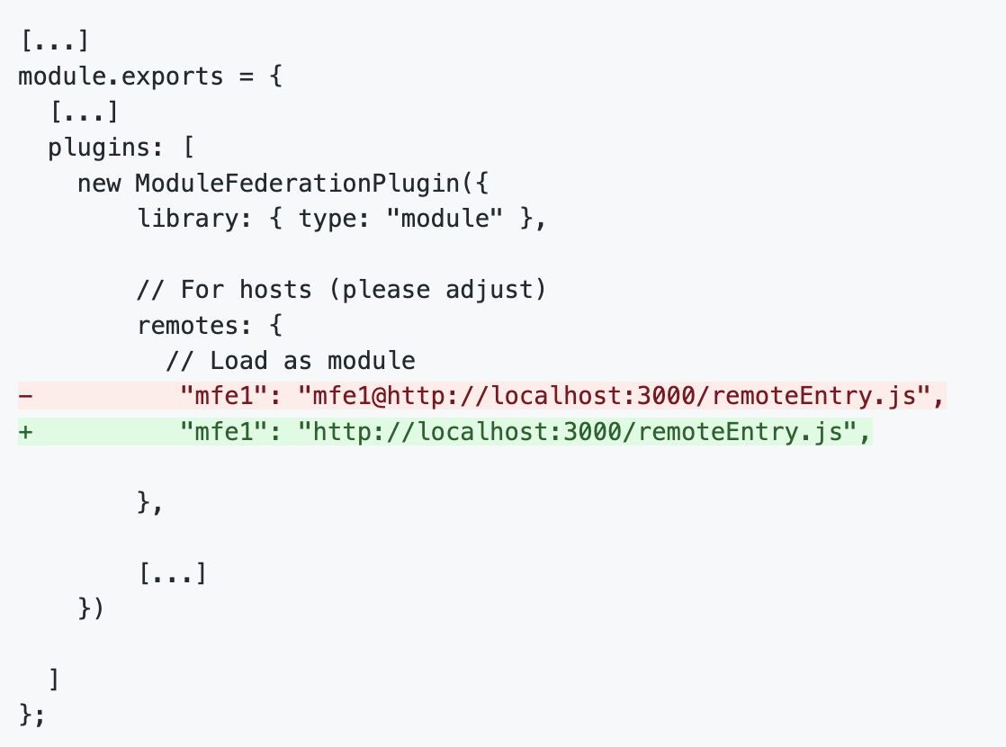
Webpack.config Changes for v13
https://github.com/angular-architects/module-federation-plugin/blob/main/migration-guide-13.md
Notes:
If you use static federation, you need to further adjust your shell's webpack config. As EcmaScript modules can be directly imported, there is no remoteName anymore. Before, this name was used as the name of a global variable that made the remote available. Hence, remove it from the values in your remotes section:

Slide 100
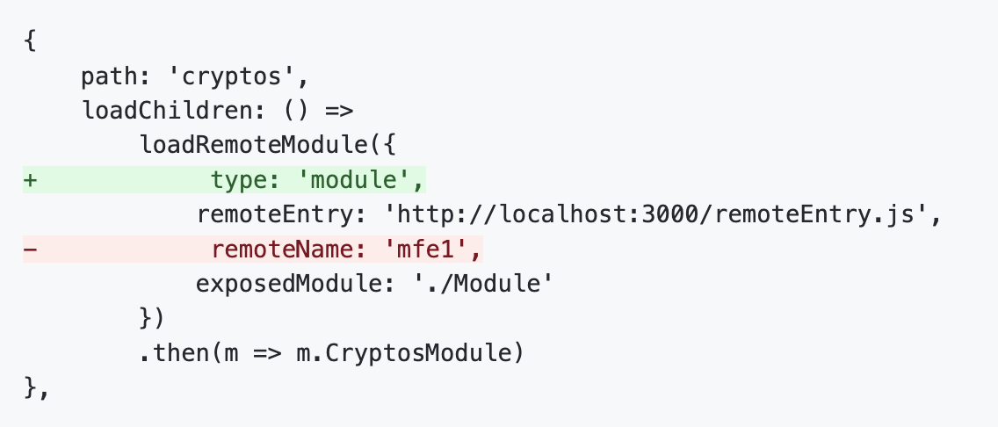
Webpack.config Changes for v13
https://github.com/angular-architects/module-federation-plugin/blob/main/migration-guide-13.md
Notes:
Update any usages of loadRemoteModule in your routes or in the main.ts depending on how you implemented module federation

Slide 101
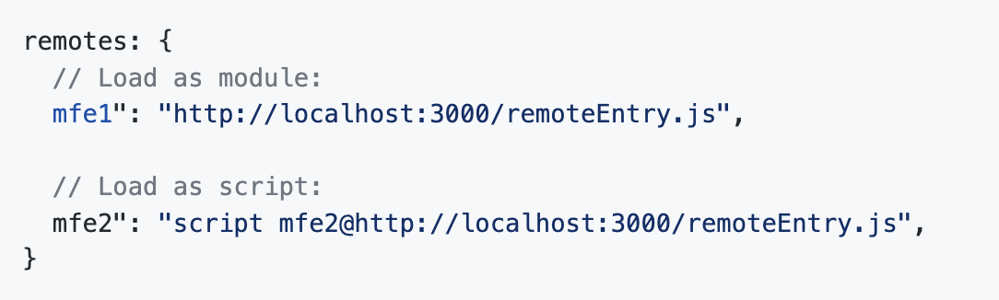
Webpack.config Changes for v13
You can use script based and ecmascript modules simultaneously as remotes
https://github.com/angular-architects/module-federation-plugin/blob/main/migration-guide-13.md

Slide 102



Webpack.config Changes for v14
Notes:
While the new version is quite shorter, it still contains the settings, one usually adjusts -- the settings passed to the ModuleFederationPlugin. The new helper withModuleFederationPlugin supports a super set of these settings and uses smart defaults.

Slide 103
Webpack.config Changes for v14
library: { type: "module" }: This is what you need for Angular >= 13 as CLI 13 switched over to emitting "real" EcmaScript modules instead of just ordinary JavaScript bundles.
filename: 'remoteEntry.js': This makes Module Federation emit a file remoteEntry.js with the remote entry point.
share: shareAll(...): This shares all packages found in the dependencies section of your package.json by default.
sharedMappings: If you skip the sharedMappings array, all local libs (aka mono repo-internal libs or mapped paths) are shared. Otherwise, only the mentioned libs are shared
Notes:
While the new version is quite shorter, it still contains the settings, one usually adjusts -- the settings passed to the ModuleFederationPlugin. The new helper withModuleFederationPlugin supports a super set of these settings and uses smart defaults.

Slide 104
Webpack.config Initialization Types
host – main application that contains a list of remote modules
remote – javascript module that can be loaded into a host application.
dynamic-host - main application that contains of list of remotes at runtime via a manifest
Notes:
While the new version is quite shorter, it still contains the settings, one usually adjusts -- the settings passed to the ModuleFederationPlugin. The new helper withModuleFederationPlugin supports a super set of these settings and uses smart defaults.

Slide 105
Shared Dependency Version Resolution
new ModuleFederationPlugin({ [...], shared: ["rxjs", “another-lib"] })
Semantic Versioning by Default from package.json
Shell: another-lib@^1.0.0
MFE: another-lib@^1.0.1
Version 1.0.1 will be used since it is the highest compatible version (minor and patch)
Shell: another-lib@~1.0.0
MFE: another-lib@1.1.0
Different versions will be used in shell and mfe since ~ indicates that only a higher patch version is compatible
Notes:
Source Code Isolation can be important

Slide 106
Dynamic Shared Dependency Version Resolution
new ModuleFederationPlugin({ [...], shared: ["rxjs", “another-lib"] })
Shell: another-lib@^1.0.0
MFE: another-lib@^1.0.1
Version 1.0.0 will be used in the shell since the requested version 1.0.1 isn’t known at the time that the application bootstraps
When the MFE is loaded, it will load it’s own version 1.0.1 per semantic versioning rules
Shell: another-lib@^1.1.0
MFE: another-lib@^1.0.0
Shell would load with version 1.1.0
MFE would use the already loaded version 1.1.0 since it is compatible
Notes:
Source Code Isolation can be important

Slide 107
Module Federation Testing
Resolving Dependencies at Runtime means shifting discovery of bugs to the right
How can we resolve the need to discover conflicts and test earlier?
Use Module Federation to federate the tests just like we federate the code
Notes:
Source Code Isolation can be important

Slide 108
Module Federation Testing
Host
Shell Capabilities
Remote 1
Crypto Catalog
Remote 2
Crypto Checkout
Test Build
Federate Tests from all other features
Notes:
Source Code Isolation can be important

Slide 109
Module Federation Testing
Host
Shell Capabilities
Remote 1
Crypto Catalog
Remote 2
Crypto Checkout
Test Build
Federate Tests from all other features
Test Build
Federate Tests from all other features
Test Build
Federate Tests from all other features
Notes:
Source Code Isolation can be important

Slide 110
Omni-Directional Hosts
Hybrid omni-directional approach
This would allow omni-directional unit testing
https://module-federation.github.io/videos
https://twitter.com/ScriptedAlchemy/status/1234383702433468416?ref_src=twsrc%5Etfw%7Ctwcamp%5Etweetembed%7Ctwterm%5E1234383702433468416%7Ctwgr%5E&ref_url=https%3A%2F%2Fcdn.embedly.com%2Fwidgets%2Fmedia.html%3Ftype%3Dtext2Fhtmlkey%3Da19fcc184b9711e1b4764040d3dc5c07schema%3Dtwitterurl%3Dhttps3A%2F%2Ftwitter.com%2Fscriptedalchemy%2Fstatus%2F1234383702433468416image%3Dhttps3A%2F%2Fpbs.twimg.com%2Fext_tw_video_thumb%2F1234383371863617536%2Fpu%2Fimg%2FlQ-uregGFW3TExzi.jpg
Notes:
Source Code Isolation can be important

Slide 111
Quiz Time!
https://ahaslides.com/microng

Slide 112
Workshop Setup
Join https://ahaslides.com/microng
Clone the following repos
https://github.com/owenmecham/module-federation-2022
https://github.com/owenmecham/ngrx-starter-2022
Install the Angular CLI
npm i -g @angular/cli
Install yarn
https://yarnpkg.com/lang/en/docs/install/

